Slide 1
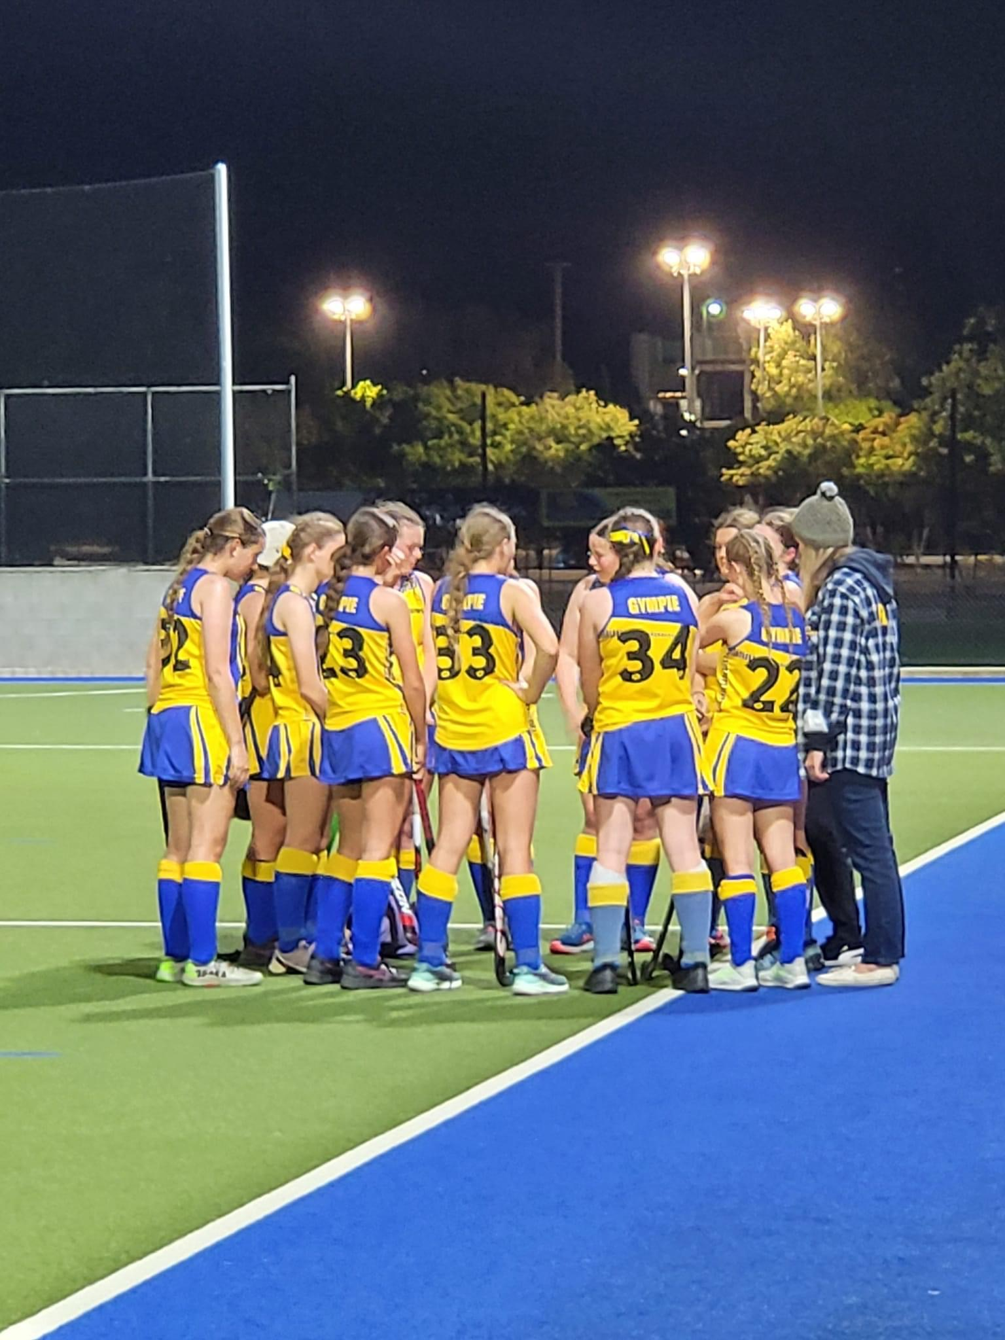
Gympie hockey academy
2023 - 2024

Slide 2
Academy Objectives
The Gympie Hockey Academy is designed to provide higher level
development opportunities for Gympie athletes aged 13-18 years.
Exposure to high level coaches and an increase in game play
experience will enhance the development trajectory of our athletes.
Assist with transition from junior hockey into
representative hockey & Cooloola Heat teams
Better overall performance from Gympie
representative teams
Greater representation of athletes at the
State representative level

Slide 3
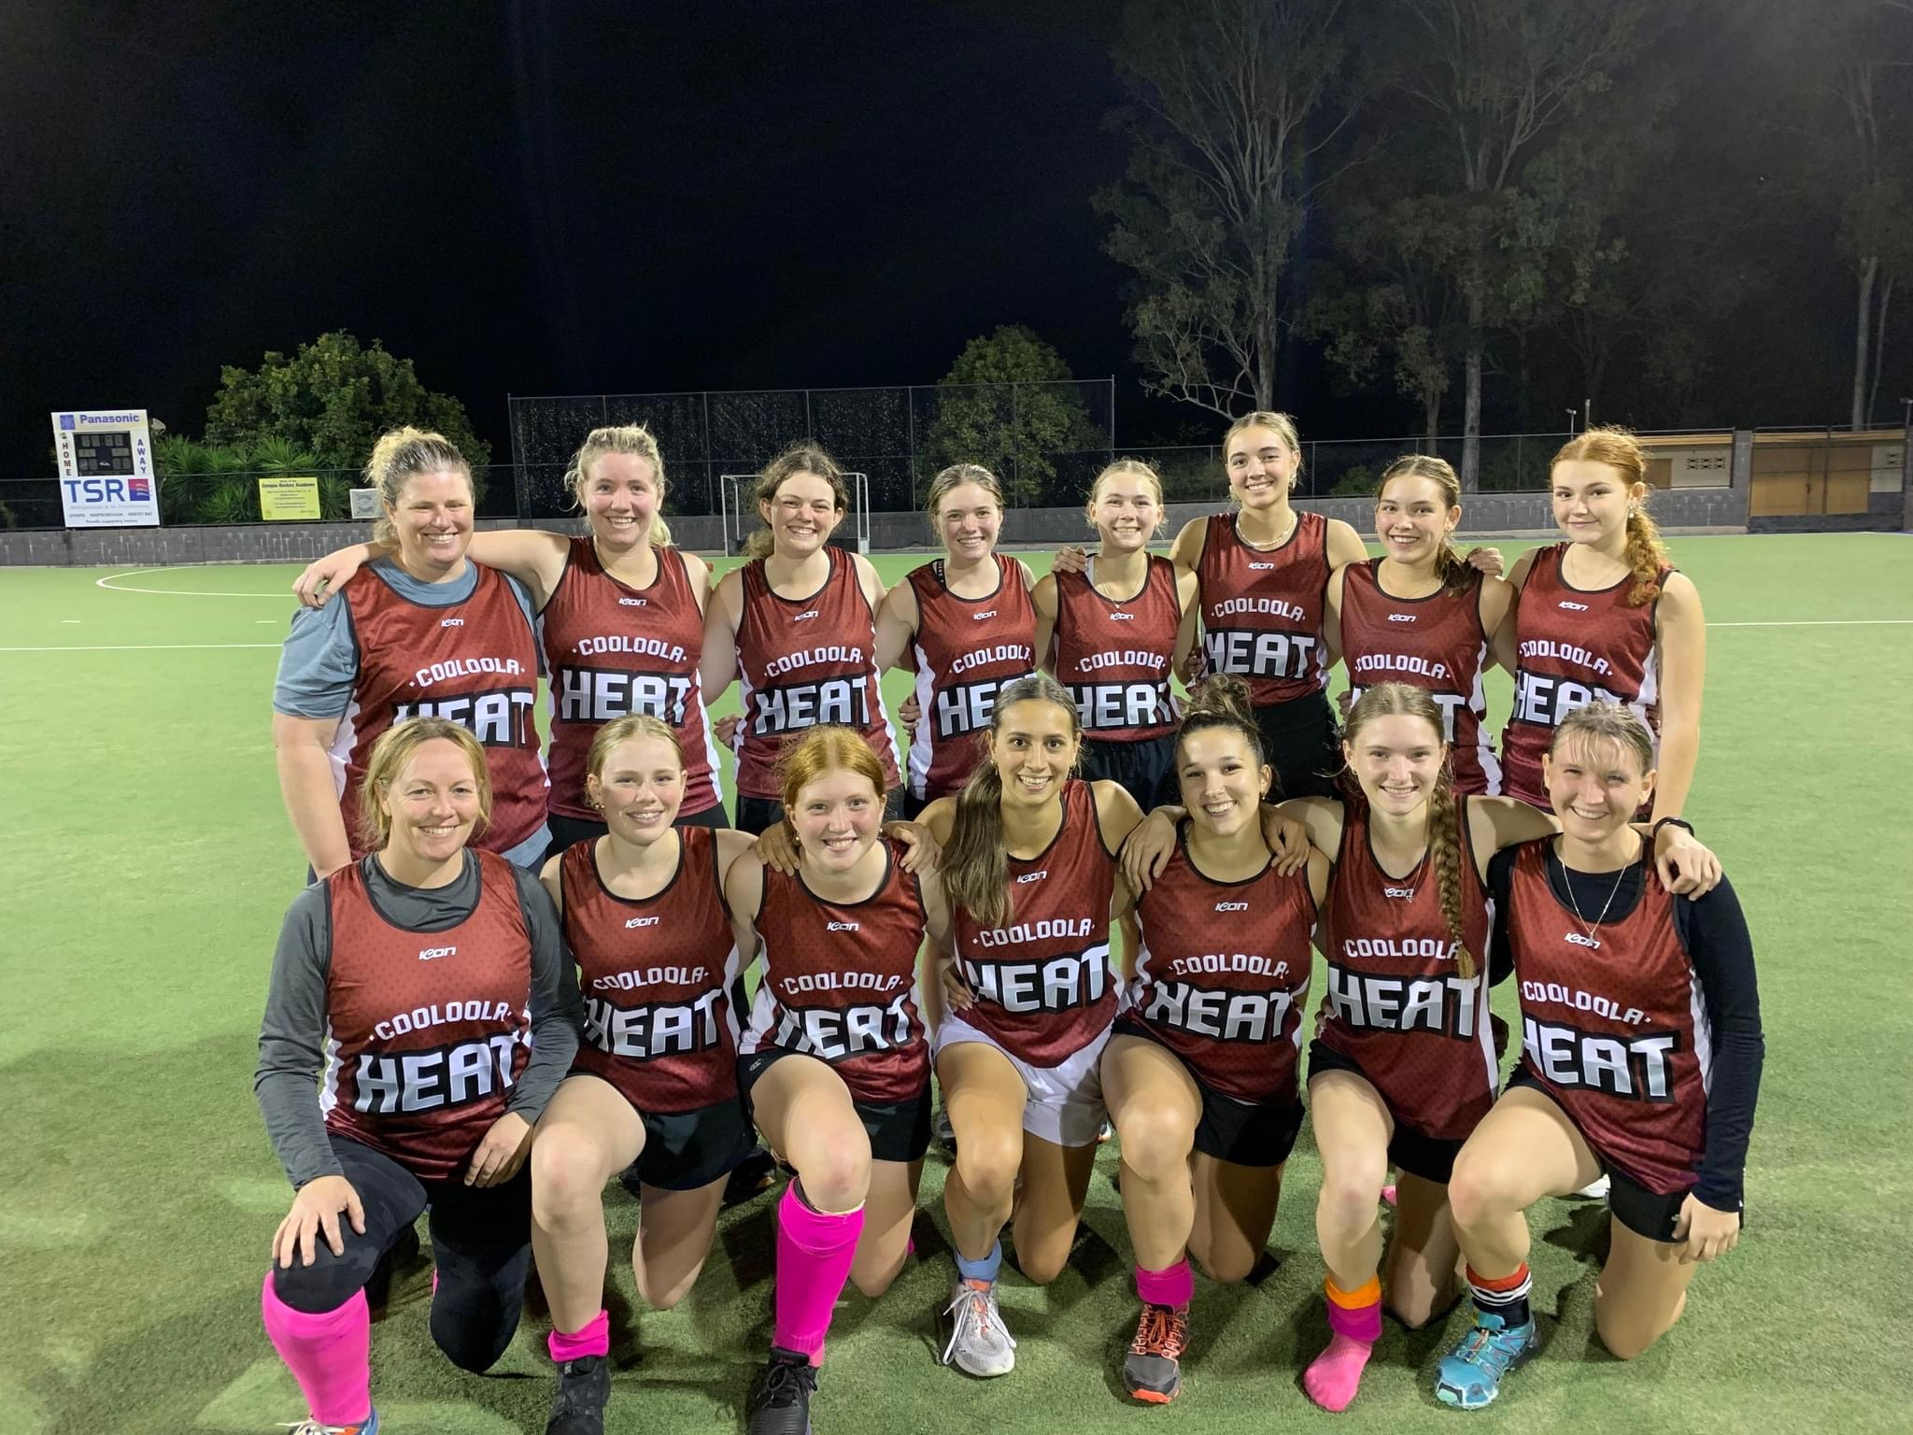
The benefits
Increase in development opportunities for athletes
Access to high level coaches
Holistic approach to development, focusing not only on hockey-specific programming.
Promotion of broader experience to enhance the learning experience.

Slide 4
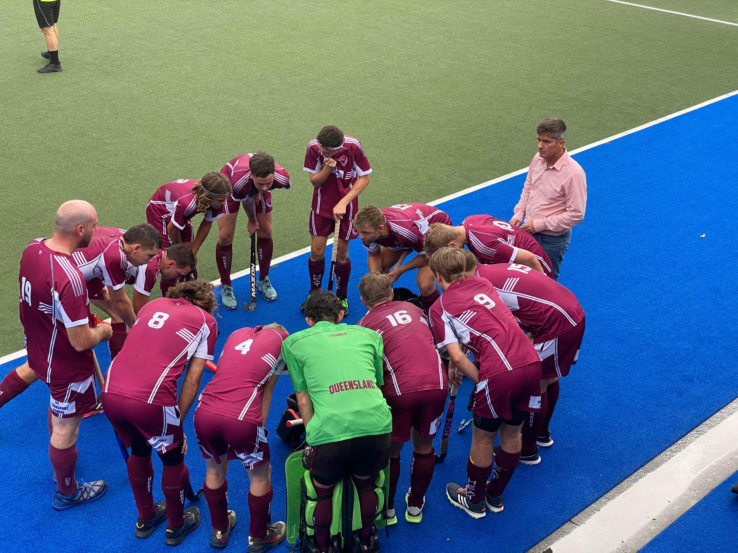
Our athletes
The Gympie Hockey Academy will be
targeted at those athletes selected in
Gympie Under 15 and Under 18 Teams
each year.
Academy programming will provide
additional development opportunities
to athletes to ensure that they are
Representative and Senior hockey
ready, and on track to maximise
their potential.

Slide 5
Academy inclusions
• Skill Development – Athletes will attend on-field skill-specific sessions i.e., distribution & receiving skills, defensive skills, elimination skills, attacking skills, set play skills, formations, all led by high quality coaches & experienced players.
Holistic Development – The Gympie Hockey Academy is about more than just hockey-specific skills. Athletes will be educated-on and practice a range of psychological and physiological skills that will further develop their ability to perform and grow.
Camps– Development camps and games will form a part of the Academy, providing athletes the chance to further hone their craft and implement learned abilities in competitive environments. Camps will also provide experiences outside of the norm, that will enhance the holistic learning environment.
Coach Development –Using the Gympie Hockey Academy to broaden our coach network is essential to maintaining the development of both the athletes within the Academy, but also the athletes participating at the grassroots level.

